Slide 1
Leave management system kan/it/2023/f/167

Slide 2
Introduction
A leave management system (LMS) is an essential tool for modern organizations to improve and automate the employee leave management process. Traditionally, managing leave requests, approving and tracking leave balances can be a tedious and error-prone task, often leading to inefficiencies in management and HR processes. By leveraging an integrated leave management system in C#, companies can provide employees with a user-friendly platform to request time off, while providing managers and HR teams with a centralized system for reviewing, approving and monitoring permission requests.

Slide 3
objective
To develop a robust Leave Management System that streamlines the process of requesting, approving, tracking, and managing employee leaves. The system will ensure better leave management, reduce paperwork, and improve operational efficiency.

Slide 4
Proposed solution
1. User Authentication: Secure login system for employees and administrators.
2. Leave Requests: Employees can apply for leave through a user-friendly interface.
3. Approval Workflow: Managers can approve/reject leave requests.
4. Leave Balance Tracking: Real-time tracking of available leave balance for each employee.
5. Leave Types: …

Slide 5
Resource requirements
Programming Language: C#
Framework: .NET Core or ASP.NET MVC
Database: SQL Server
IDE: Visual Studio

Slide 6
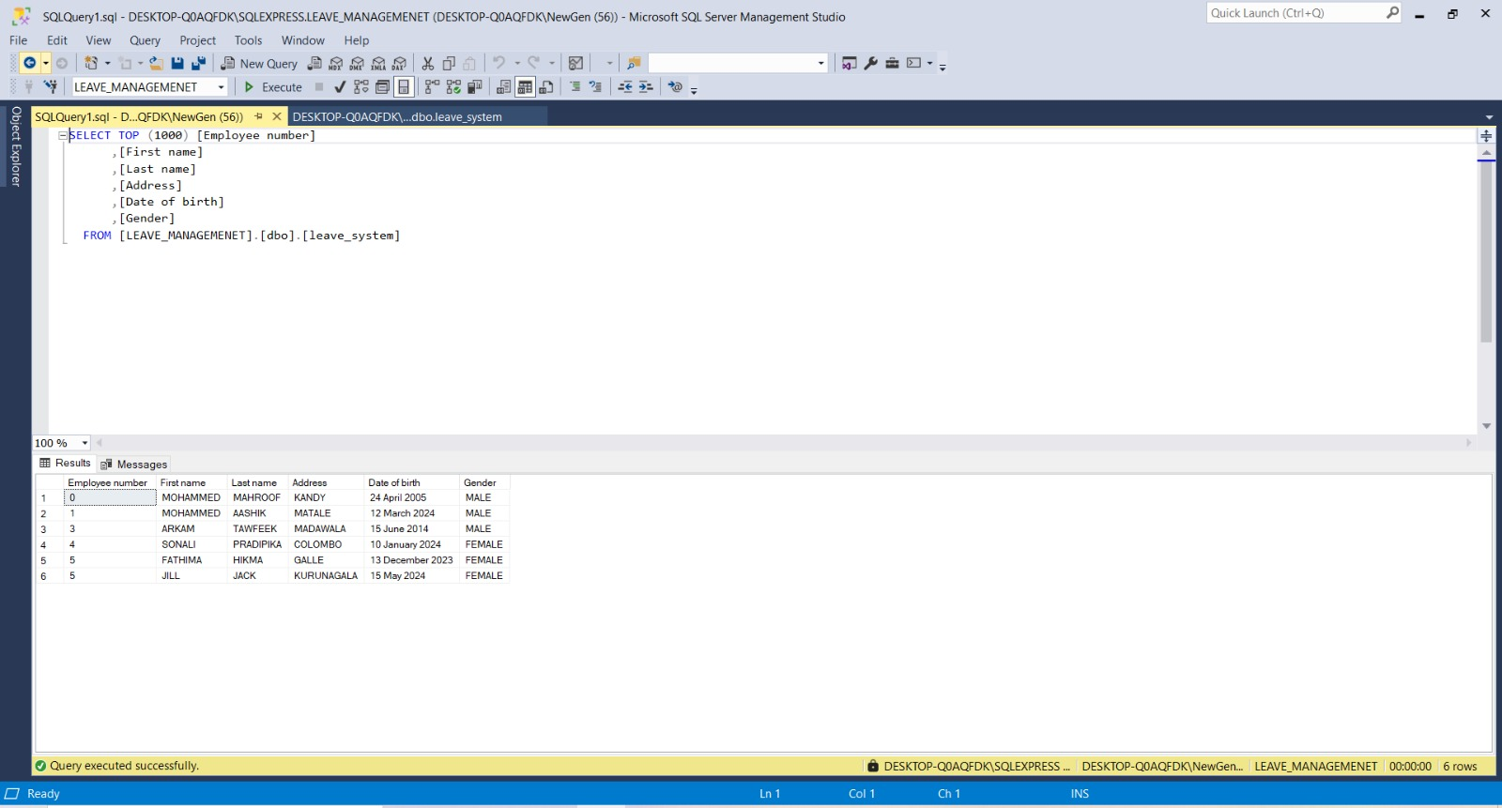

Slide 7
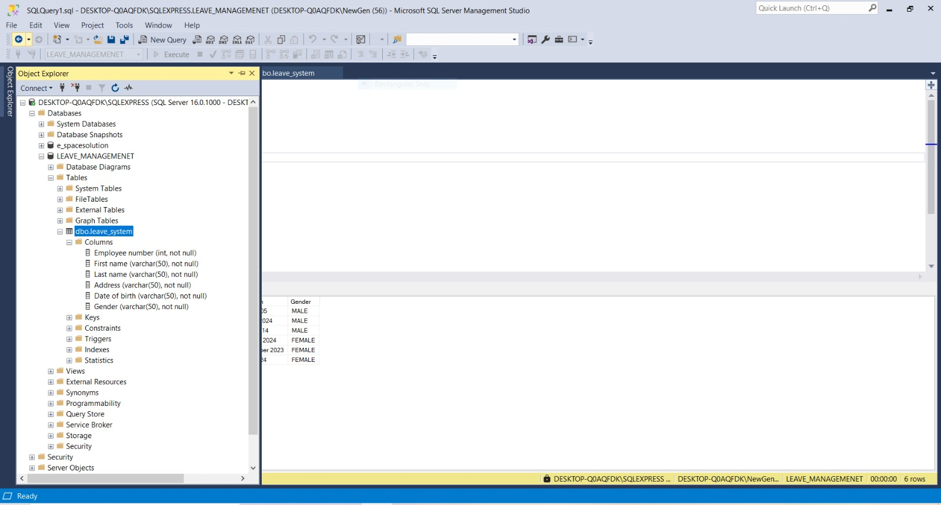

Slide 8
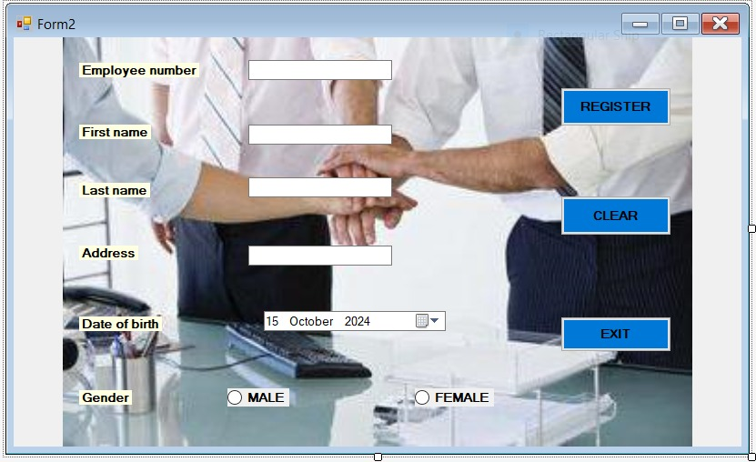

Slide 9
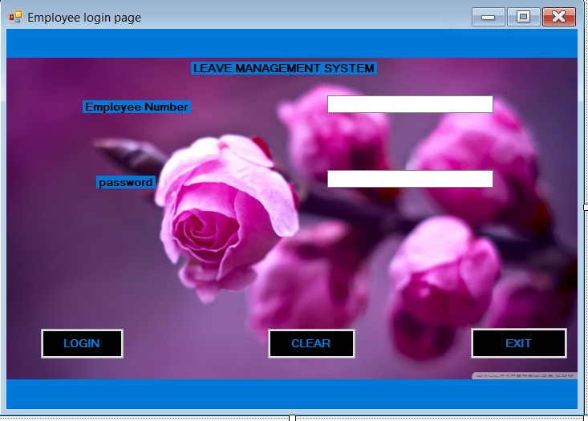

Slide 10
